Slide 1
Lecture 8 Software Engineering System Modeling
Dr. Mohamed ElAraby

Slide 2
Agenda
Static structure model
Class diagrams

Slide 3
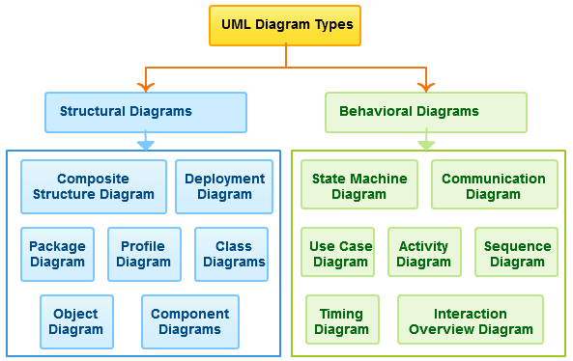

Slide 4
Structural models Class diagrams
Class diagrams are used when developing an object-oriented system model to show the classes in a system and the associations between these classes.
An object class can be thought of as a general definition of one kind of system object.
An association is a link between classes that indicates that there is a relationship between these classes.

Slide 5

Structural models Class diagrams
Class diagrams in the UML can be expressed at different levels of detail. The first stage is usually to look at the world, identify the essential objects, and represent these as classes.
Each patient has exactly one record and each record maintains information about exactly one patient.

Slide 6
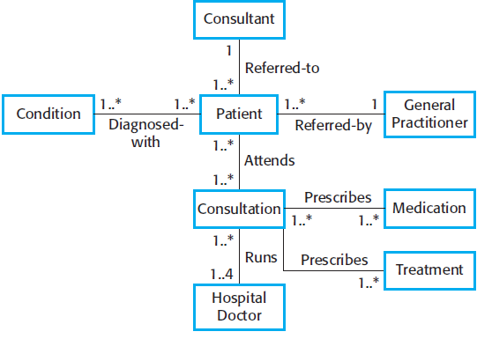
Classes & Associations MHC-PMS

Slide 7
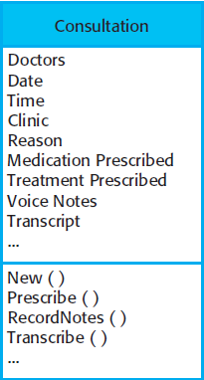
Structural models Class diagrams
To define them in more detail, add information:
Attributes (the characteristics of an object),
Operations(things that you can request from an object)
A Patient object will have the attribute Address
Include an operation called ChangeAddress,
which is called when a patient indicates
that they have moved from one address
to another.

Slide 8
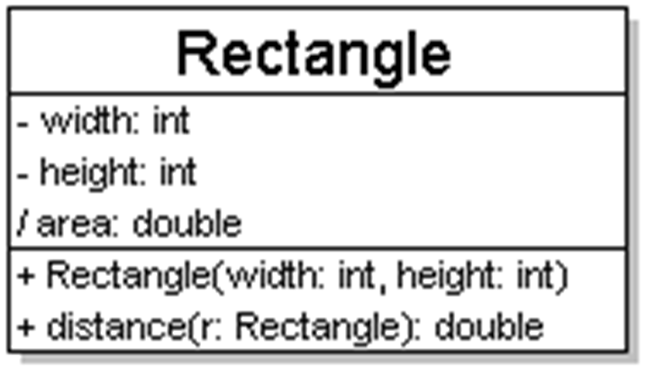
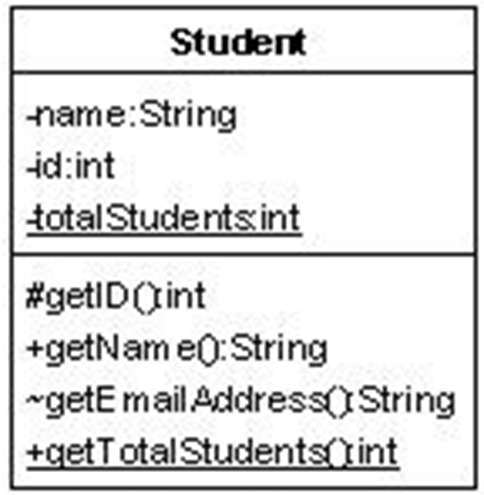
Structural models Class diagrams
class name in top of box
write <<interface>> on top of interfaces' names
use italics for an abstract class name
attributes (optional)
should include all fields of the object
operations / methods (optional)
may omit trivial (get/set) methods but don't omit any methods from an interface!
should not include inherited methods

Slide 9
Class attributes (= fields)
attributes (fields, instance variables)
visibility name : type [count] = default_value
visibility:
+ public
# protected
- Private
~ package (default)
/ derived
underline static attributes
derived attribute: not stored, but can be computed from other attribute values
“specification fields “ from CSE 331
attribute example:
balance : double = 0.00

Slide 10
Class operations / methods
operations / methods
visibility name (parameters) : return_type
visibility:
+ public
# protected
- Private
~ package (default)
underline static attributes
parameter types listed as (name: type)
omit return_type on constructors and when return type is void
method example:
+ distance(p1: Point, p2: Point): double

Slide 11
Relationships between classes
generalization: an inheritance relationship
inheritance between classes
interface implementation
association: a usage relationship
Dependency
Aggregation
composition

Slide 12
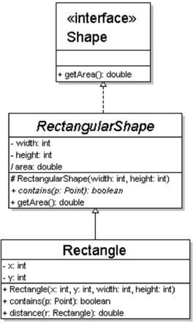
Generalization (inheritance) relationships
Hierarchies drawn top-down
arrows point upward to parent
line/arrow styles indicate whether parent is a(n):
class:
solid line, black arrow
abstract class:
solid line, white arrow
interface:
dashed line, white arrow
often omit trivial / obvious generalization relationships, such as drawing the Object class as a parent

Slide 13
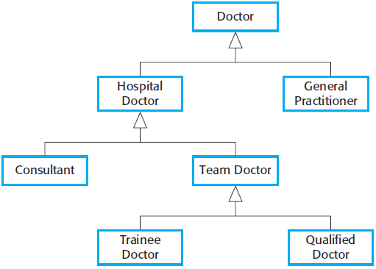
Structural models Class diagrams: Generalization

Slide 14
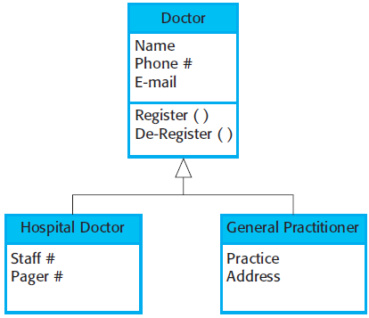
Structural models Class diagrams: Generalization

Slide 15
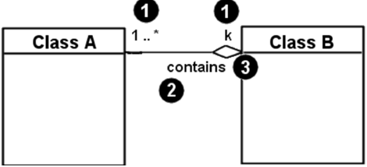
Associational relationships
associational (usage) relationships
multiplicity (how many are used)
* ⇒0, 1, or more
1 ⇒1 exactly
2..4 ⇒between 2 and 4, inclusive
3..* ⇒3 or more (also written as “3..”)
name (what relationship the objects have)
navigability (direction)

Slide 16
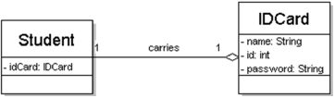
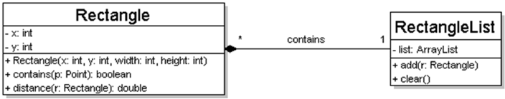
Multiplicity of associations
one-to-one
each student must carry exactly one ID card
one-to-many
one rectangle list can contain many rectangles

Slide 17
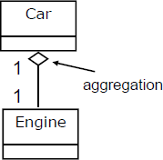
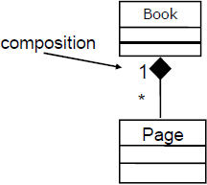
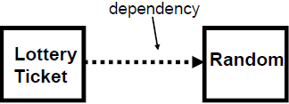
Association types
aggregation: “is part of”
symbolized by a clear white diamond
composition: “is entirely made of”
stronger version of aggregation
the parts live and die with the whole
symbolized by a black diamond
dependency: “uses temporarily”
symbolized by dotted line
often is an implementation detail, not an intrinsic part of that object's state

Slide 18
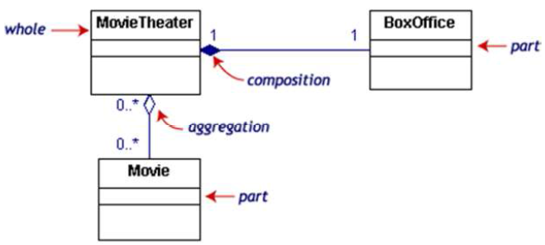
Composition/aggregation example
If the movie theater goes away
so does the box office => composition
but movies may still exist => aggregation

Slide 19
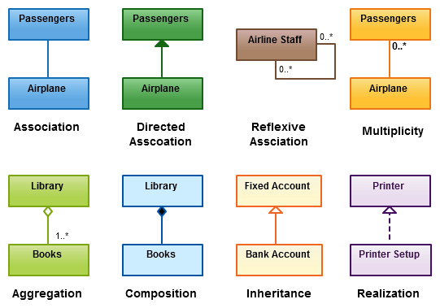
Class Diagrams Relationships

Slide 20
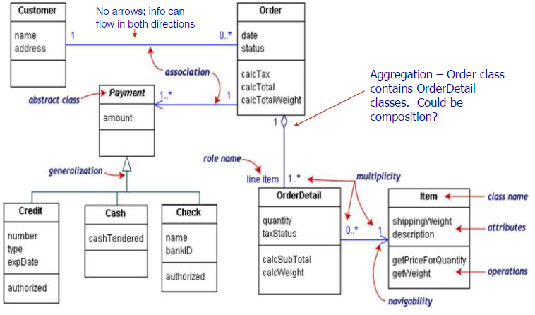
Class diagram example

Slide 21
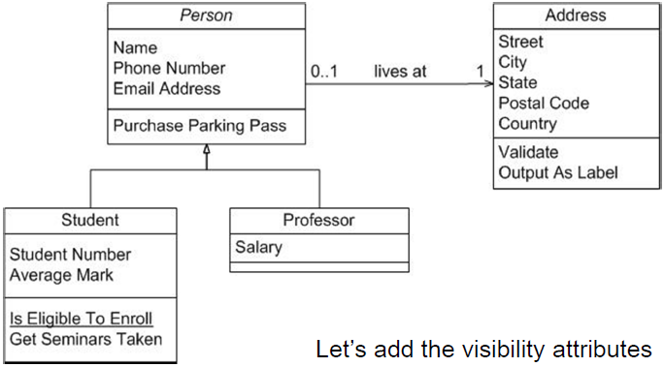
UML example: people

Slide 22
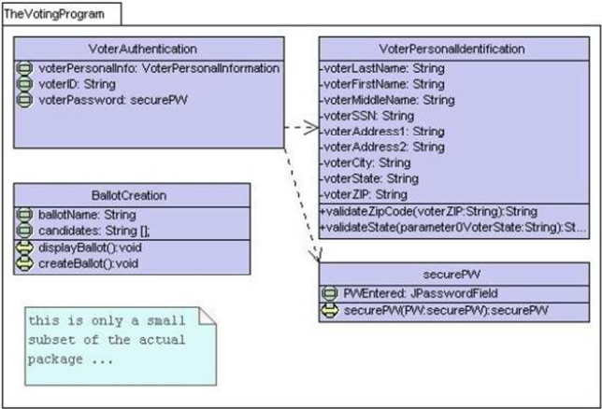
Class diagram: voters

Slide 23
Tools for creating UML diagrams
Violet (free)
http://horstmann.com/violet/
Rational Rose
http://www.rational.com/
Visual Paradigm UML Suite (trial)
http://www.visual-paradigm.com/
(nearly) direct download link:
http://www.visual-paradigm.com/vp/download.jsp?product=vpuml&edition=ce
(there are many others, but most are commercial)

Slide 24
Class diagram pros/cons
Class diagrams are great for:
discovering related data and attributes
getting a quick picture of the important entities in a system
seeing whether you have too few/many classes
seeing whether the relationships between objects are too complex, too many in number, simple enough, etc.
spotting dependencies between one class/object and another
Not so great for:
discovering algorithmic (not data-driven) behavior
finding the flow of steps for objects to solve a given problem
understanding the app's overall control flow (event-driven? web-based? sequential? etc.)

Slide 25
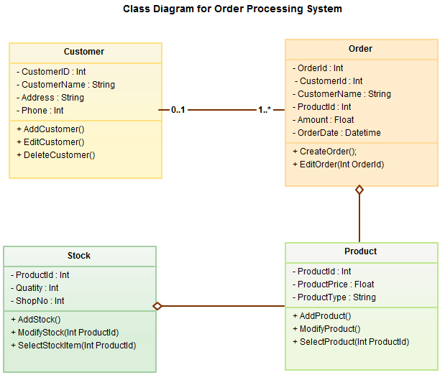
UML Class Diagram with Relationships

Slide 26
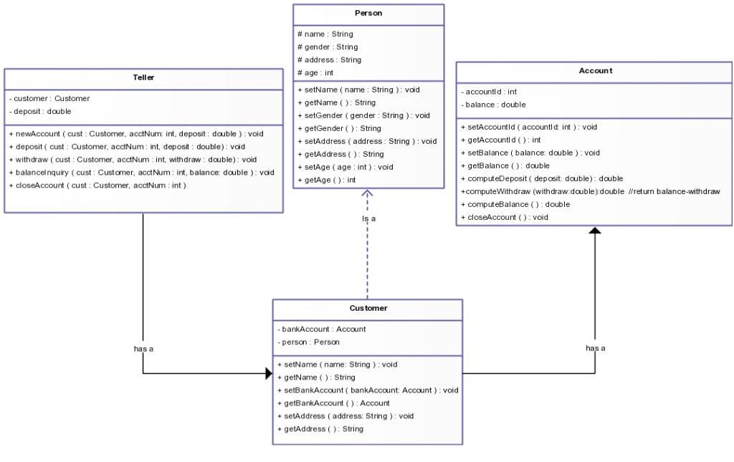
Bank System

Slide 27
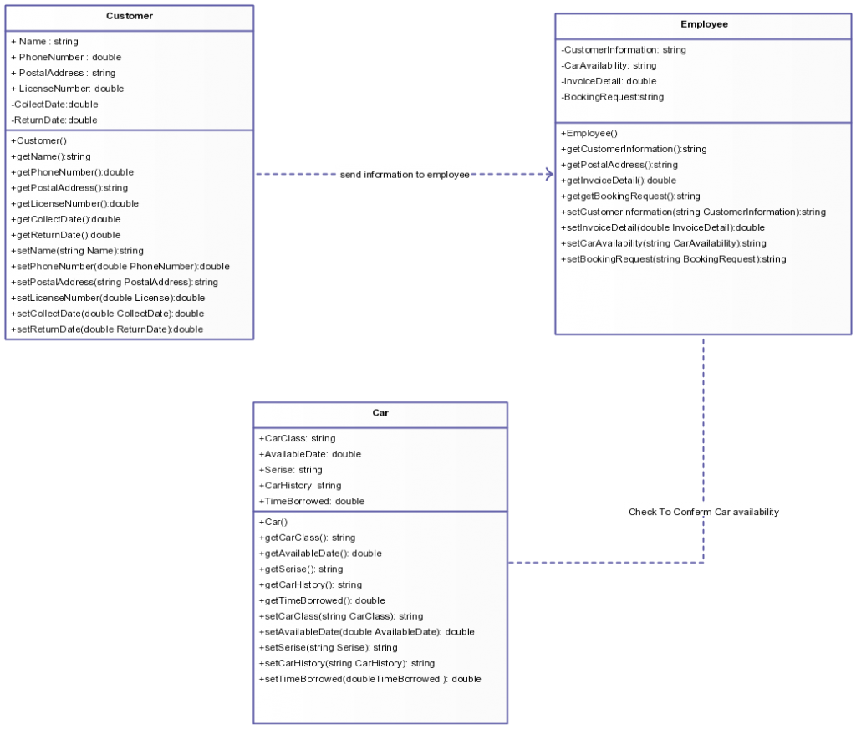
Car Rental System

Slide 28
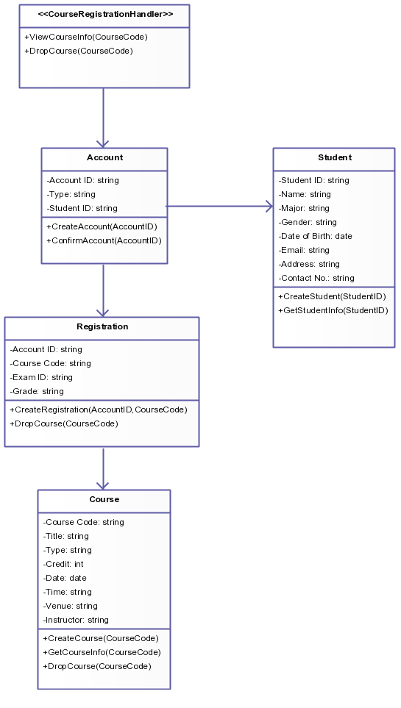
Course Registrations System

Slide 29
Any Question?

